Slide 1
TAPAS Project – Final Presentation
St.Gallen, 18th December 2023
Group 5

Slide 2




The Team
Kaan Aydin
Michael Brülisauer
Daniel Leal
Stephan Nef
Notes:
Gladly no changes in our team

Slide 3







Key Architecture Changes
Communication Flows
Decoupling
Demonstration
Outlook & Contributions
Agenda
Notes:
We'll cover in today presentation our
key architecture changes and major improvements presented by myself...
...then Kaan will present you our communication flows,
...and Daniel then will take over and present our efforts towards decoupling,
.. At the end you will get as well a live demonstration from Michi, together with our outlook and contributions to this field.
Event Storming Board, Architecture Characteristics, Architectural Styles, Service Design, and Application Flow

Slide 4
Key Architecture Changes
Communication Flows
Decoupling
Demonstration
Outlook & Contributions
Agenda
Notes:
Microservice Architecture (Scalability, Interoperability)

Slide 5






Implementation of the Auction House
Major improvements since last presentation
Implementation of WebSub & MQTT
New Executors (Robot & MiroCard)
Improvements to the Task List database
Code Cleaning & Refactoring
TAPAS Project – Final Presentation
18 December 2023
5
Notes:
Lets start with our Major improvements since last presentation...We have made some good progress...
We have implemented the auction house 4weeks ago
Introduced and implemented then WebSub and MQTT for real-time communication 3weeks ago, enjoyed then a nice PlugFest...
We have also added the 2 new executors such as robots and MiroCards last week
we improved our task list database (taks status update)
and we tried continously cleaned-up and refactored our Code
End
The Auction House service sends the task information to the winning bidder's team task, creating a shadow task
The winning bidder's executor successfully completes task & sends updates the original task list

Slide 6

Architecture | What we implemented until our last mid-term presentation…
Client requests
Client requests
Client requests
Client requests
API layer
Calculator
Task List
Roster
Executor Pool
Executors
Coding
Manifesto
TAPAS Project – Final Presentation
Notes:
Let's take a look at our architecture prior to these improvements/changes.
We had this known straightforward setup where client requests were handled through an API layer, connecting to our Task List, Roster, and a pool of Executors.
This structure served us well, but we all know...it lacked the flexibility we needed/ or lets say missed the functionallity for cross-team coordination/communication. Therefore....

Slide 7
Architecture | … and now we added the Auction House to communicate with other groups
We implemented the Auction House as a new service to execute:
Internal tasks for which we do not have an executor
External tasks for which we have an executors
We also added two new executors:
The Miro Card
The Robot
ADRs 15, 17
Client requests
Client requests
Client requests
Client requests
API layer
Calculator
Task List
Roster
Executor Pool
Auction House
Executors
Coding
Manifesto
Miro Card
Robot
Newly implemented
TAPAS Project – Final Presentation
Notes:
Therefore....we've integrated the Auction House into our architecture.
This addition acts as an additional service:
to execute, on the one hand, internal tasks without a designated executor and...
And on the other hand, to handle external tasks when we have the necessary resources.
And we can see we've also added the Miro Card and Robot to our list of executors to diversify our task handling capabilities.

Slide 8
The Auction House acts as the point of coordination and communication with the other groups
Via the Auction House, we can either:
launch an auction when no internal executor is found
bid on an auction from another group only if a suitable executor exists
We implemented two communication protocols: WebSub and MQTT
Architecture | Deep-Dive into the Auction House
Bidding Process
1
2
3
Receive notification
Check internal capabilities
Bid on auction
Auction Process
1
2
3
Publish new Auction
Receive Bids
If bid(s) received, send task to winner
Notes:
Zooming into the Auction House, our central point of coordination and communication with other groups:
The Auction House is structured to either launch or bid on auctions, ensuring task allocation is efficient and effective.
Bidding Process: first step...second and third step
Auction Process: first step...second and thirs step
The use of WebSub and MQTT protocols has been crucial in this setup, allowing us instant communication and a robust bidding and auction process.
That's it for our overview of the changes we've implemented. With these let's now deep dive to the Communication Flow, which Kaan will now navigate us through.
Ende:
WebSub:
Real-Time Updates: WebSub provides real-time updates to subscribers when a publisher has new content. In the context of an Auction House, this means that as soon as a new task is available for bidding, all interested executors (subscribers) can be immediately notified.
Decoupling: This protocol decouples the producer of information (the Auction House, in this case) from the consumers (executors). The Auction House doesn't need to know who the subscribers are; it simply informs the hub, and the hub takes care of the distribution.
Scalability: Since the hub handles notifications, the Auction House can scale without being burdened by the overhead of managing individual subscriptions.
MQTT:
Efficiency: MQTT is designed for low-bandwidth and unreliable networks, which makes it highly efficient for sending small messages between devices, like bid proposals or auction results.
Quality of Service (QoS) Levels: MQTT offers different levels of delivery guarantees, ensuring that messages such as bids are delivered according to the required level of reliability.
Retained Messages: MQTT can retain the last message on a topic, which can be crucial for ensuring that late subscribers receive the current state of an auction.
Last Will and Testament: This feature can notify other parts of the system if an executor or the Auction House disconnects unexpectedly, which can trigger contingency protocols or re-auctions.

Slide 9
Key Architecture Changes
Communication Flows
Decoupling
Demonstration
Outlook & Contributions
Agenda
Notes:
Event Storming Board, Architecture Characteristics, Architectural Styles, Service Design, and Application Flow

Slide 10

Communication Flows | Task Flow with Internal Assignment
Graphical Illustration
Explanation
No databases
1
User adds a task to the task list
2
Task List sends added task to Roster
Roster
4
Executor Pool
3
Roster sends request to Pool with the Task Type
3
4
Pool returns to Roster a list of executors with the right type
2
5
Task List
7
Executor - Calculator
5
Roster sends task location (i.e., URI) to the Executor, starting execution
Executor - ChatGPT
6
6
Executor reads user input for task from Task List
8
1
7
Executor executes task and updates task output & status in Task list
Communication over HTTPS / JSON requests
8
User can view the task output
USER

Slide 11
Communication Flows | Task Flow with External Executor
Graphical Illustration
Explanation
ADRs 15
Excl. bidding
1
User adds a task to the task list
4
2
Task List sends added task to Roster
Roster
Executor Pool
3
Roster sends request to Executor Pool with the Task Type
3
5
2
4
Executor Pool CANNOT return an executor with the requested type
Internal Auction House
Internal
Task List
5
Roster sends task location (i.e., URI) to the auction house, starting auction
6
7
1
6
Auction house select winning bid and creates shadow task at ext. task list
8
7
External provider executes task and updates our internal task list
External
Task List
8
User can view the task output
USER

Slide 12
Communication Flows | Task Flow with External Task
Graphical Illustration
Explanation
ADRs 15
Excl. bidding
1
Our auction house sends bid to another auction house, if capabilities match
Roster
5
Executor Pool
External auction house creates shadow task in our task list
2
4
3
Task List sends shadow task to roster
3
6
Roster sends request to Pool with the Task Type
4
Internal Auction House
Internal
Task List
7
Executor - Calculator
Executor - ChatGPT
5
Pool returns to Roster a list of executors with the right type
2
8
1
6
Roster sends task location (i.e., URI) to the Executor, starting execution
8
External Auction House
External
Task List
7
Executor reads user input from Task List
External provider executes task and updates our internal / external task list
8

Slide 13
Communication Flows | Crawling via Semantic Hypermedia
High-level process:
Crawl through auction feeds
Interpret the semantic content of headers
Subscribe to topics of interest
Query
ADRs 16
Advertise
Topics of interest
Our Group
Topics to publish
Group 1
1
HTTP link headers are used to understand the types of resources they reference
Joking
Calculating
Explaining
Prompting
2
2
…
Decisions are made based on the semantic information extracted from these link header and whether it aligns with the client’s current interests
Group 2
Group 3
Joking
Talking
Calculating
Experimenting

Slide 14
Key Architecture Changes
Communication Flows
Decoupling
Demonstration
Outlook & Contributions
Agenda
Notes:
Event Storming Board, Architecture Characteristics, Architectural Styles, Service Design, and Application Flow

Slide 15
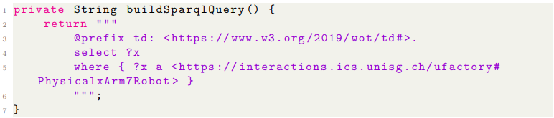

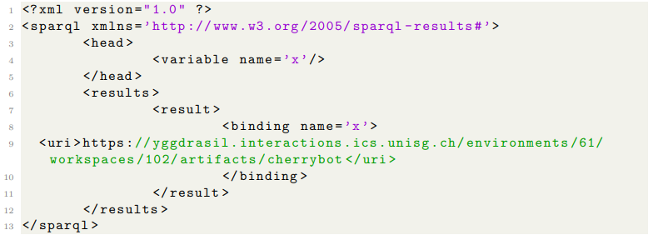
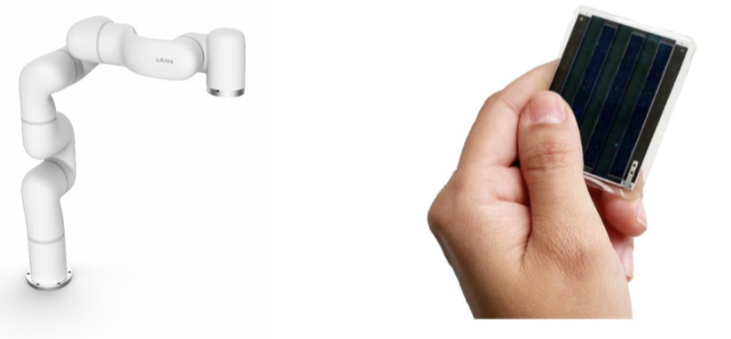
Decoupling | Hypermedia API
1
Send SPARQL Request
ADRs 17
Executors
Knowledge Graph
Executor - Calculator
1
Executor – MiroCard
2
Receive URIs of Devices
2
Executor - Calculator
Devices
Executor – Robot
3
3
Extract TD from Device URI and generate HTTP Post Request
4
4
Receive status response from device
TAPAS Project – Final Presentation
18 December 2023
Notes:
Lastest technical development
Expanding application to interacting with devices (Web of Things)
Introduces a dynamic system that is changing
We address these changes by decoupling

Slide 16
Key Architecture Changes
Communication Flows
Decoupling
Demonstration
Outlook & Contributions
Agenda
Notes:
Event Storming Board, Architecture Characteristics, Architectural Styles, Service Design, and Application Flow

Slide 17

Standard process for internal task assignment (i.e., with an executor that is not hard-coded)
Auction House discovery at run time through semantic hypermedia
Auctioning process (i.e., receive bid, select bid, delegate task, task execution)
Demo Time

Slide 18
Key Architecture Changes
Communication Flows
Decoupling
Demonstration
Outlook & Contributions
Agenda
Notes:
Event Storming Board, Architecture Characteristics, Architectural Styles, Service Design, and Application Flow

Slide 19



Outlook | Limitations and Improvements
Current limitations
Potential data inconsistencies (e.g., database flags)
Limited monitoring / logging
No ingestion controls / bandwidth mgmt.
…
Further improvements
Implementation of async communication
Code Library for executors / communication
Develop front-end / SWAGGER UI
…
Notes:
To conclude we would like to discuss current system limitiations and taking the time to look
The fundamental core functional is completed. Now we would like to refine the solution because we found the current limitations and potential for further potential.
As we wrap up, let's quickly have a look on our bumps and wins!
We hit some tough spots with technical stuff like Hexagonal and Microservices, Docker deployment, compiling, and using JMeter for checks. Sure, they were hard, but lets focus on what we have learned so far!
We got better understanding how to let microservices services talk to each other, we became testing nearly professionals (not quite there yet but we learn some things there), we had a deeper look at how to setup databases, …and teamed up on GitHub and Trello...next Slide.

Slide 20



Outlook | Troubles & Learning
Troubles
MQTT implementation
Alignment with the interoperability TF
Memory issues with the VM
Inefficient debugging over VM / deployment
….
Learning
Use SSH to access to VM for efficient debugging
Early developers define “path forward” for interoperability standard
Methods & applications around decentralized communication and decoupling
Plugfests are a lot of fun
…
Notes:
Now, to reflect on what we have learned in the last 6 weeks.
As we wrap up, let's quickly have a look on our bumps and wins!
We hit some tough spots with technical stuff like Hexagonal and Microservices, Docker deployment, compiling, and using JMeter for checks. Sure, they were hard, but lets focus on what we have learned so far!
We got better understanding how to let microservices services talk to each other, we became testing nearly professionals (not quite there yet but we learn some things there), we had a deeper look at how to setup databases, …and teamed up on GitHub and Trello...next Slide.

Slide 21
Contributions | We were able to distribute the group work quite fairly within our team
Kaan
Michael
Daniel
Stephan
Auction House
WebSub
MQTT
Other services
Semantic HM
New Executors
Documentation

Slide 22
Any questions?

